Slide 1
Effects of Cord clamping in preterm infants
Joshua Moe, Sonu Ojha, Bryan Quintana, Kel Amede, Nicoletta sheppard

Slide 2

Intro/data fetching

Slide 3
Data process
Dataset consists of 353 rows and 36 columns.
Should ‘died’ or ‘survwithoutmajormorbidity’ be the ‘target’?
Dropped columns 'hct1224' and 'hct1236’ then dropped any rows containing any NaN value(s)—preserved 310 rows of data. (not dropping the two column results in losing over a third of our data).
After cleaning the dataframe, no entries where a subject died remained. Even if we didn’t drop columns 'hct1224' and 'hct1236’, less than 5% of the entries had subjects who ‘died’. Went with ‘survwithoutmajormorbidity’ for a better target split of close to 4/1 (yes/no) ratio.

Slide 4
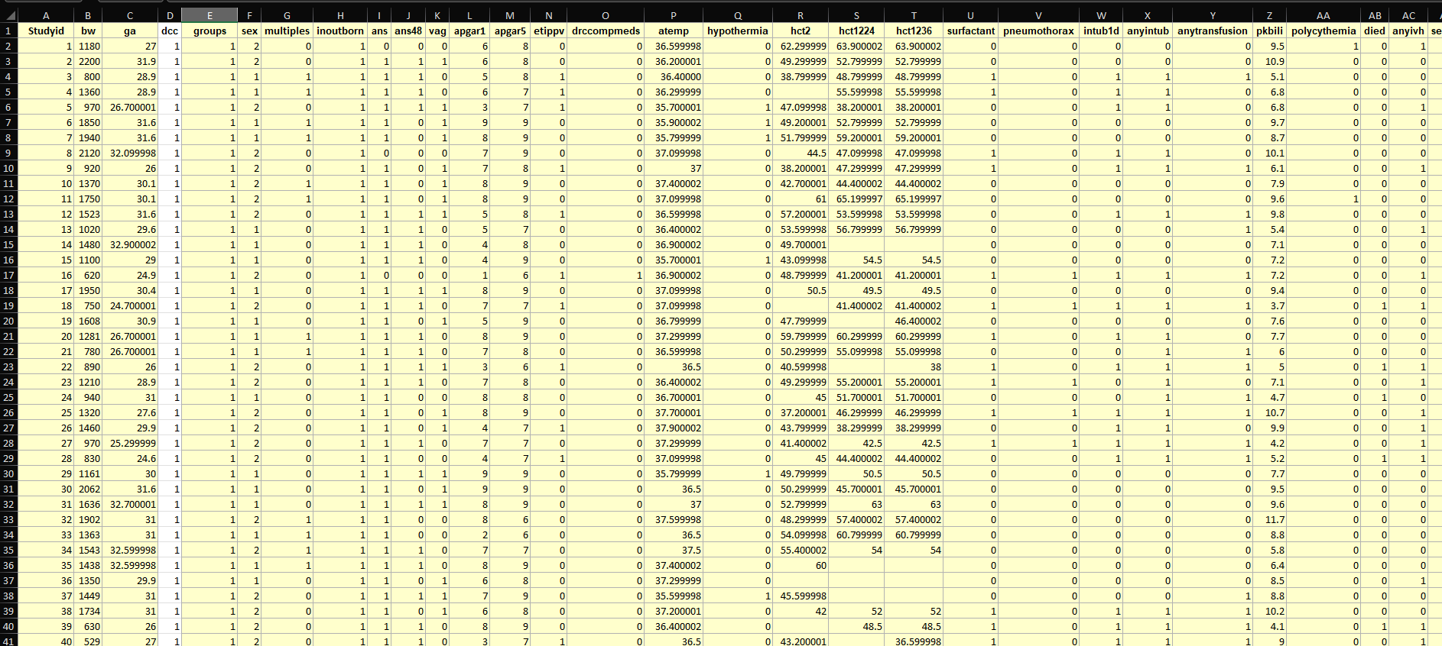
visual

Slide 5
Machine learning model
Logistic Regression Classification Module.
Thirty-Three columns as Features. The ‘survwithoutmajormorbidity’ column as the Target.
Procedure:
Train-test-split the data (after ETL).
Scale the features with StandardScaler().
Create a Logistic Regression model (random_state=1)
Fit the model
Make prediction and Evaluate accuracy of predictions made.

Slide 6
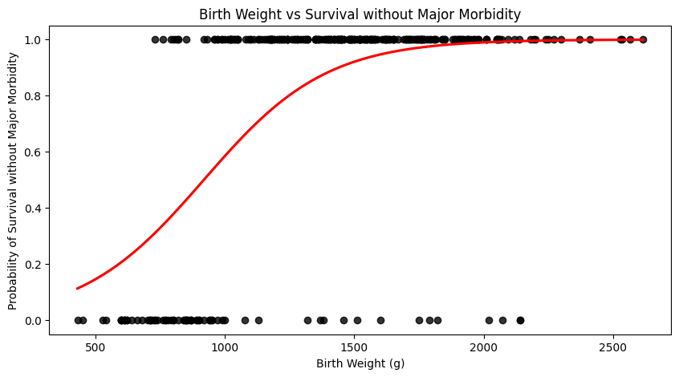
visual

Slide 7
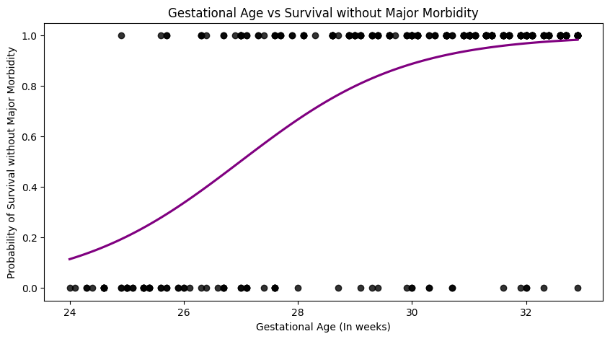
visual

Slide 8
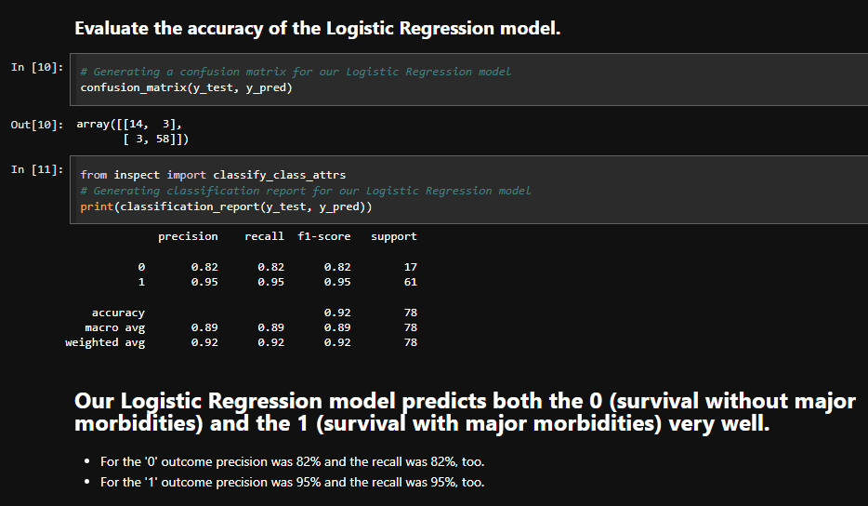
Testing/documentation
Confusion Matrix
…
…
Classification Report
…
…

Slide 9
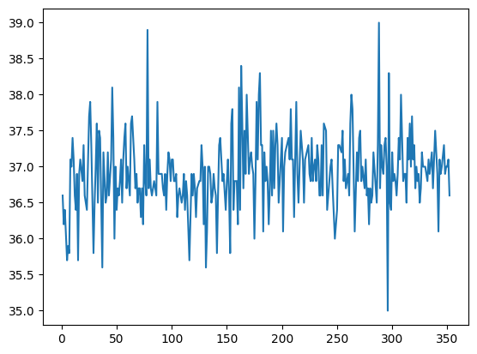
visual
This graph has relationship between each infant and their admission temperature. Infants admitted with temperature less than 36 degree Celsius had hypothermia.
Admission temperature in Celsius
Study Id

Slide 10
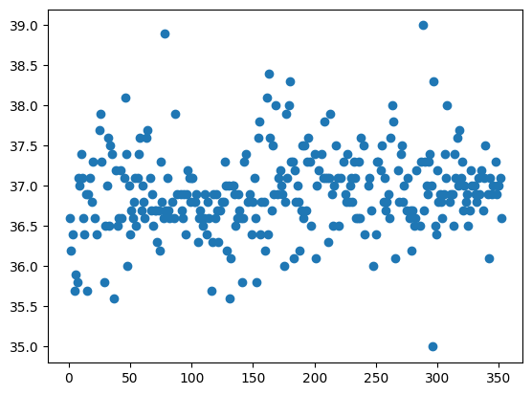
This graph is similar to last slide but it shows the data in scattered form.
Admission temperature in Celsius
Study Id

Slide 11
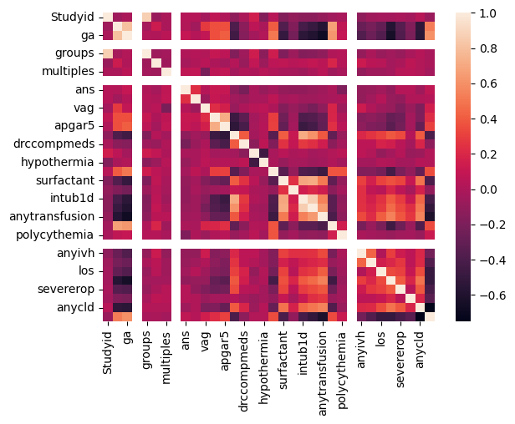
visual
This graph is showing correlation between multiple variables as a color coded matrix. Lighter shade is showing the highest correlation between columns. Darker shade represents lower correlation.

Slide 12

Summary of findings
Summary Point
Point 1
Point 2
Point 3
…

Slide 13
Work cited
Song, Dongli; Jegatheesan, Priya; DeSandre, Glenn; Govindaswami, Balaji (2016). Data from: Duration of cord clamping and neonatal outcomes in very preterm infants [Dataset]. Dryad. https://doi.org/10.5061/dryad.4q3d3

